Slide 1
Ask Weber
Session 3
Topic 7
askweber.github.io

Slide 2
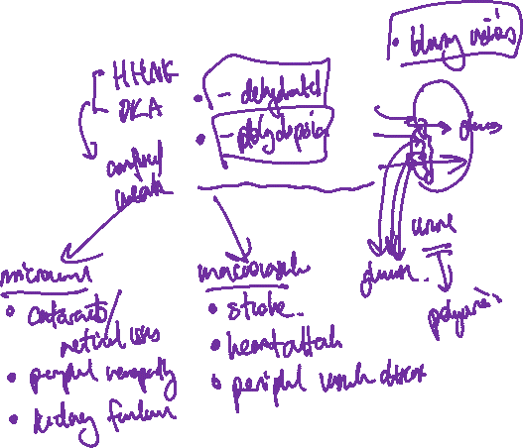
Symptoms of hypoglycaemia
Symptoms of hyperglycaemia
Effects of hyperglycaemia (acute)
Effects of hyperglycaemia (chronic)

Slide 3
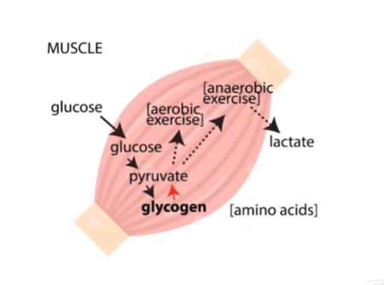
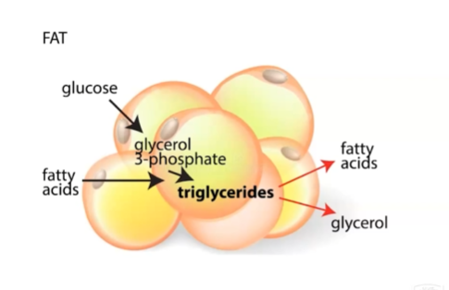
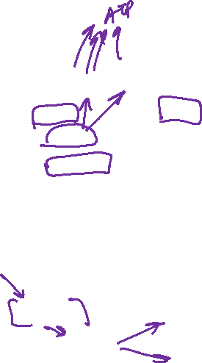
Describe the process in which glucose is used in muscle tissue
Describe the process in which glucose is turned into fats in fat cells

Slide 4
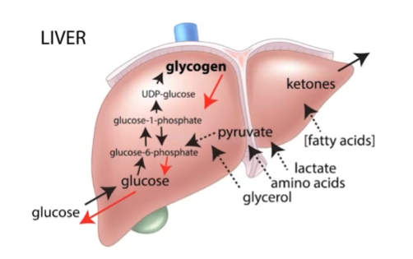
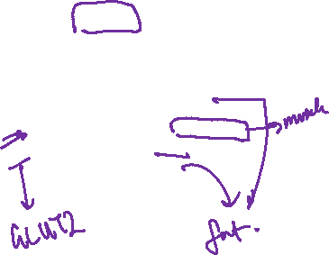
Describe the process in which glucose is stored in the liver
In the ketogenic diet, the participant aims to stop intake of carbohydrates (i.e. anything that will produce glucose). Describe the process in which ketones are made

Slide 5
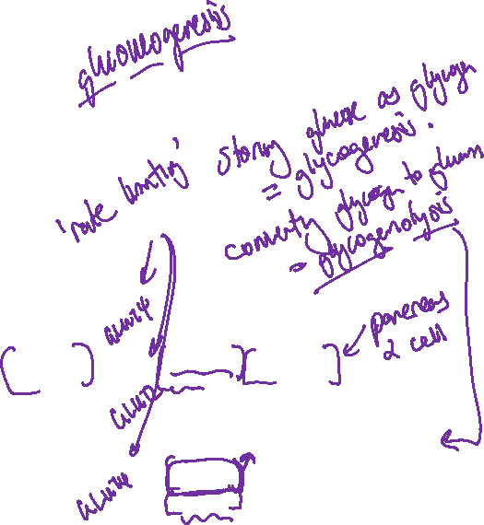
List the targets of insulin and the ‘action’ insulin takes at these targets (muscle, liver, fat)
List the targets of glucagon and the ‘action’ it takes at these targets.
Notes:
Insulin upregulates glucose transporter (glut4) in the membrane of muscle cells
Insulin also upregulates glut4 in fat cells in membrane of fat cells
i.e. it OPENS UP the gate – this is rate limiting step
What does rate limiting mean?
Liver is glut2 transporter – we believe insulin increases rate of glycogenesis

Slide 6
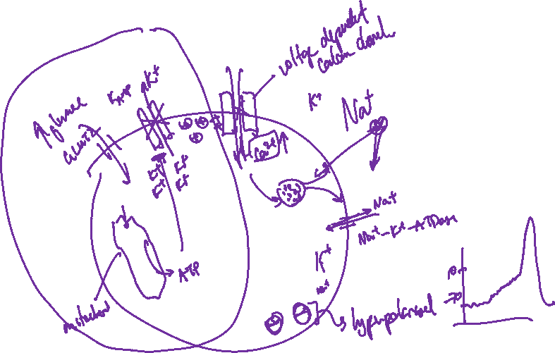
Describe the MOA of how glucose in the blood can result in the release of insulin

Slide 7
Where do you find pancreatic beta cells

Slide 8
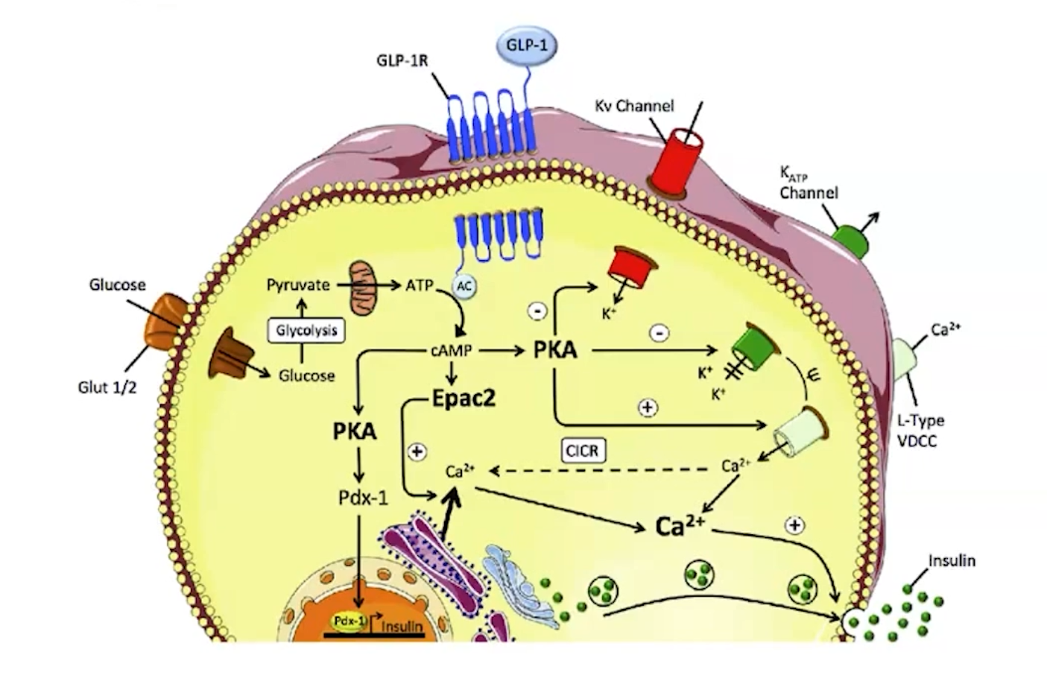
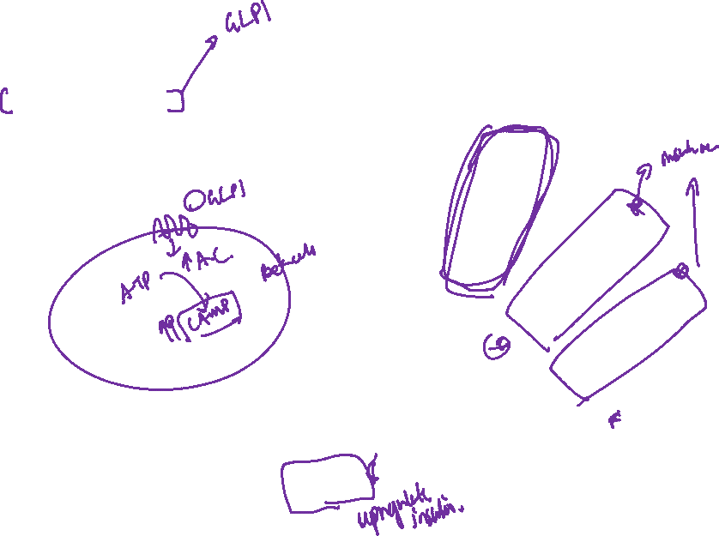
Exenatide is a medication used in Type 2 diabetes. It is pharmacodynamically similar to the glucagon-like peptide 1, and thus acts as a glucagon-like peptide 1 receptor agonist. Describe what direct enzyme the receptor acts on, and its downstream effects on pancreatic function

Slide 9
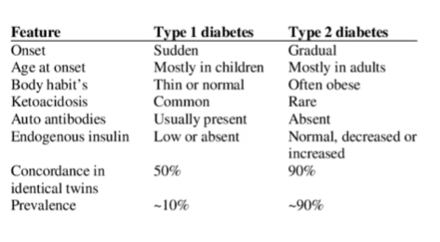
Type 1 diabetes
Describe the mechanism of Type 1 diabetes and its pathophysiology, including explanation of polyuria and polydipsia
Type 1 diabetes is inheritable (T/F)
Type 2 diabetes is inheritable (T/F)
Notes:
An autoimmune disease

